Slide 1
SMART PARKING
Abhijeet Kumar Thakur | OPD20032
Shivam Batra | OPD20022
Sumit Tyagi | OPD20002
Ravindra Pawar | OPD20003
Sachin Kumar Yadav | OPD20013
K Swaviman | OPD20014
Akansha Khanna | OPD20020

Slide 2
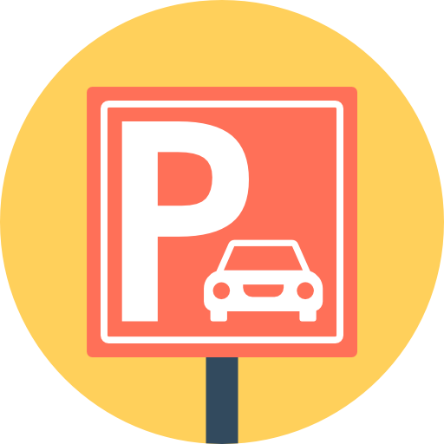
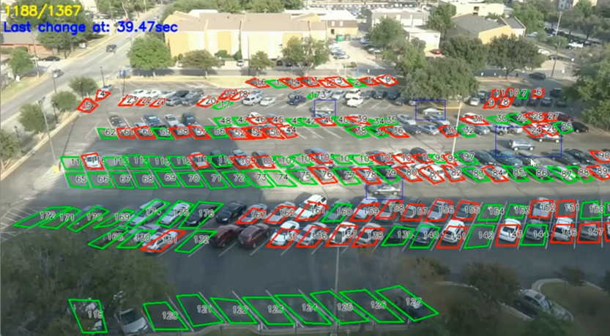
SMART ARKING
PROBLEM STATEMENT
Smart parking provides a way to use minimum resources to accommodate large number of vehicles eﬃciently. The idea could be to optimize how parking should be managed in order to minimize clutter and chaos.
PROBLEM DESCRIPTION
Problem is to accommodate maximum vehicles in minimum available parking space. We need to divide available parking space into Equal slots bounded by marked edges. Challenge is to convert this into a computational Problem. Worst case could be all slots in all parking lots are Occupied. Even though the space is available it is hard for the driver to find the available space That’s why he roam around finding space in chaos.

Slide 3

Approach Followed
We’ll divide parking space into equal unit spaces by painted lines, each unit space can accommodate a vehicle.
To convert it into a computation problem we’ll use Computer Vision and Machine Learning. Initially we"ll set up camera to get live feed. Then the image preprocessing will be done using grayscaling, gaussian blur, canny edges techniques. After detecting edges we"ll maintain the database of available and occupied slots in various parking lots. Now problem is to select best available parking slot.
Now, whenever a new vehicle enters then it must share the expected stay time and then if space is available then Dijkstra's algorithm will be applied to get nearest slot. A token will be generated possessing a Lot and slot no e.g. LOT1SLOT23. So that car will be directed to a lot with minimum waiting time and to a slot which is nearest available to it. And if space is not available then some inventory management will be performed using stay time provided by users and hence vehicle will be directed to lot which have slot with minimum waiting time.
Inventory management Algorithms will deal with worst case by reducing wait time hence providing the best slot to wait for.
And there will be no clutter and chaos since each driver will have a token number where he should park the vehicle.

Slide 4
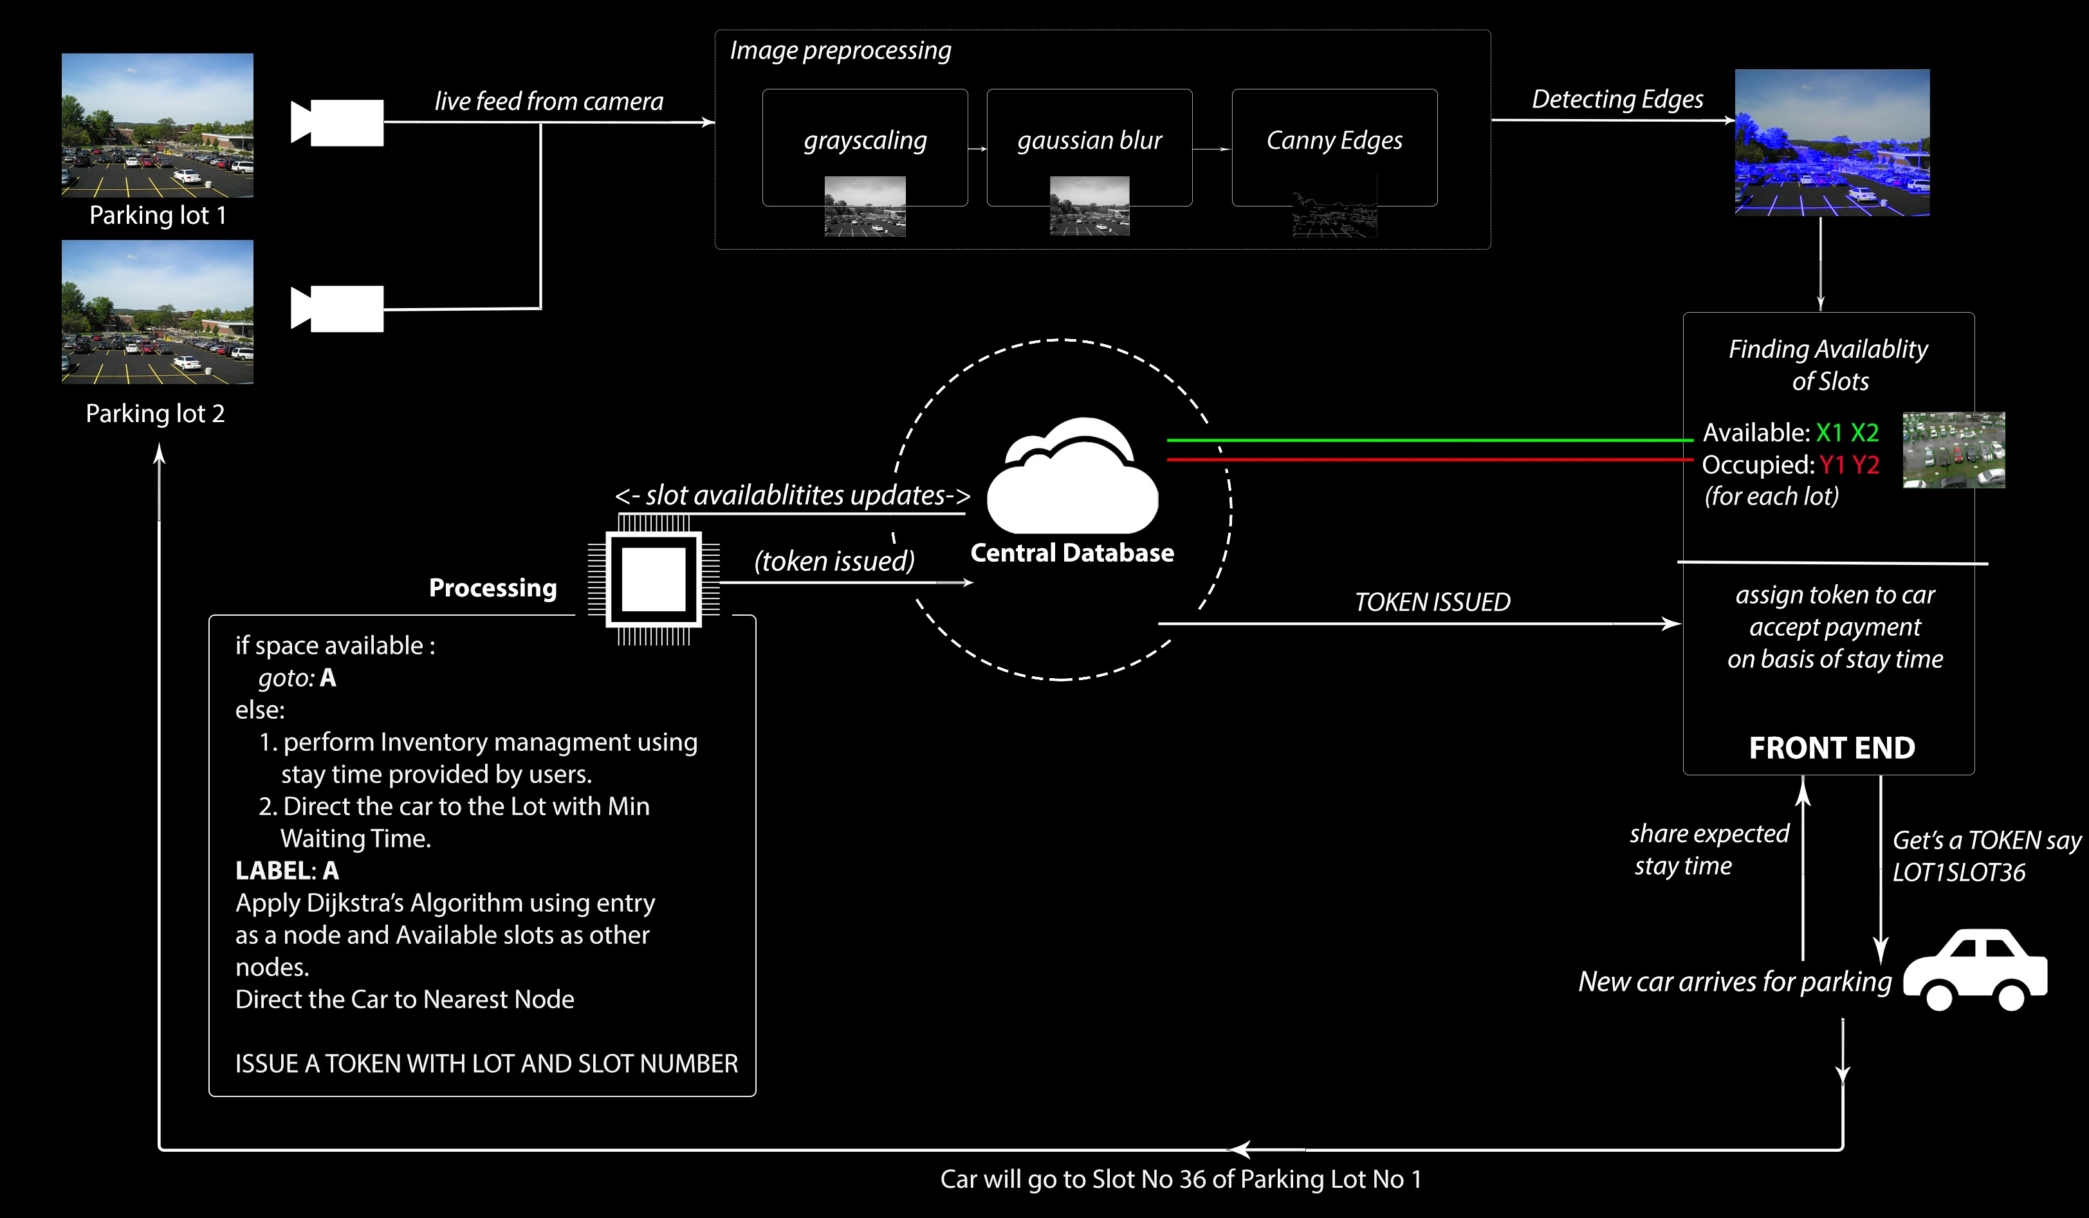
Flow Diagram

Slide 5


